Slide 1
Data Analysis Project
Present by : Rahul Makwana

Slide 2
About project :-
We have giving of three data sets of weather report in year – 2011.
In this data set much more duplicate values and empty cells and also
this data sets not find any such kind of information.
Our role is identify problems of data sets and apply data wrangling techniques and find of useful data for further usage.

Slide 3
Flow chart of Data processing : -
Data set 5
Data set 4
Data set 1
Data set 2
Data set 3
Data set 3
Merge Data sets of 1 and 2
Sample Data sets
final Data set

Slide 4
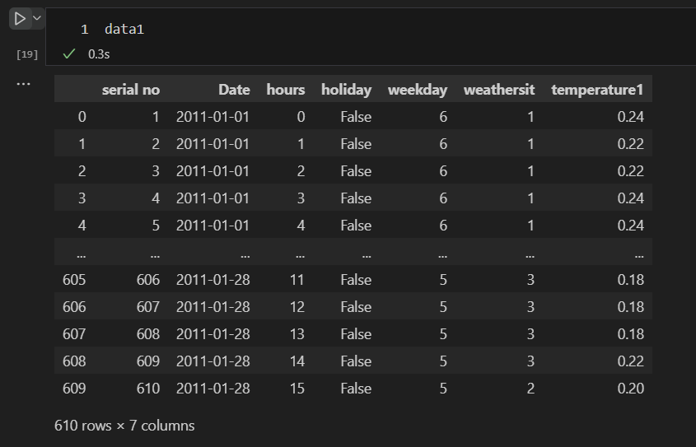
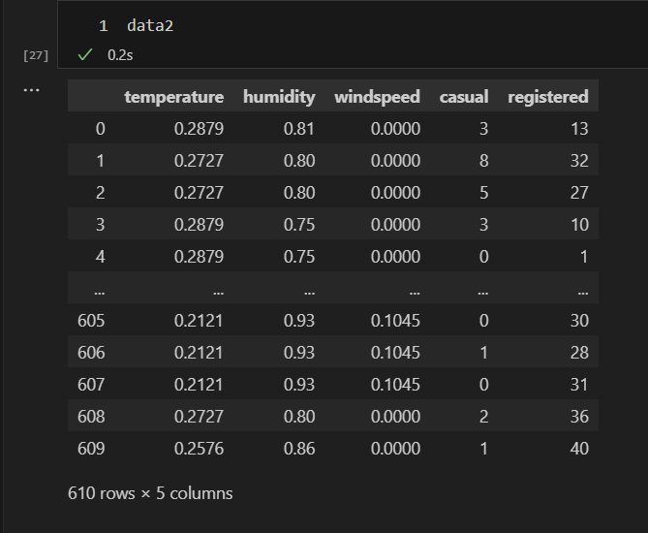
Data sets Details :-
Data set 1
Data set 2
Rows and columns after cleaning of set 1
Rows and columns after cleaning of set2

Slide 5
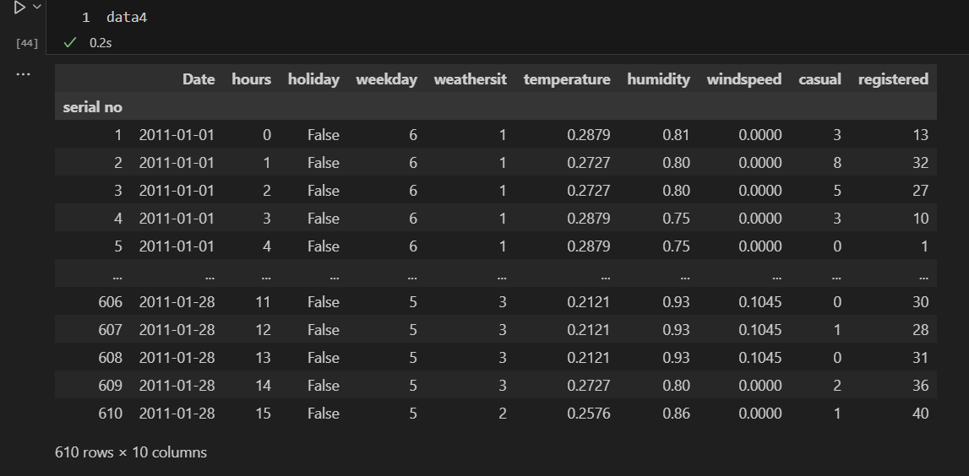
Data set 4 details :-
After cleaning a dataset 1 and 2 then both dataset Concat and making a new dataset of data 4.
In data set 4 remove Duplicate rows , columns so after data4 new rows and columns find as per pic.

Slide 6
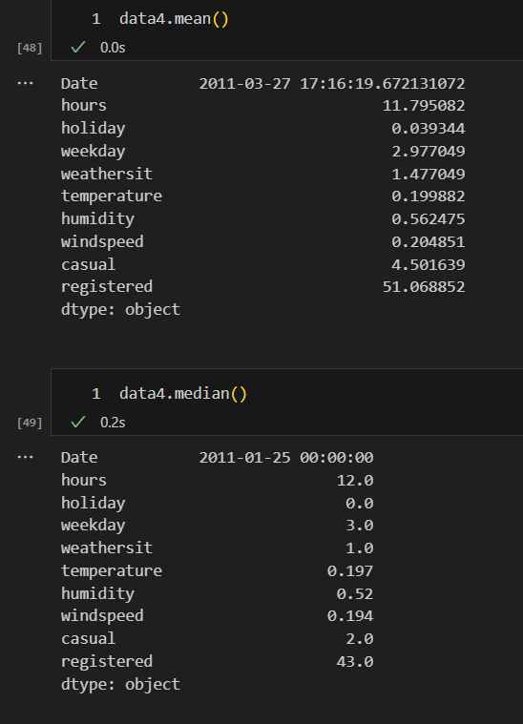
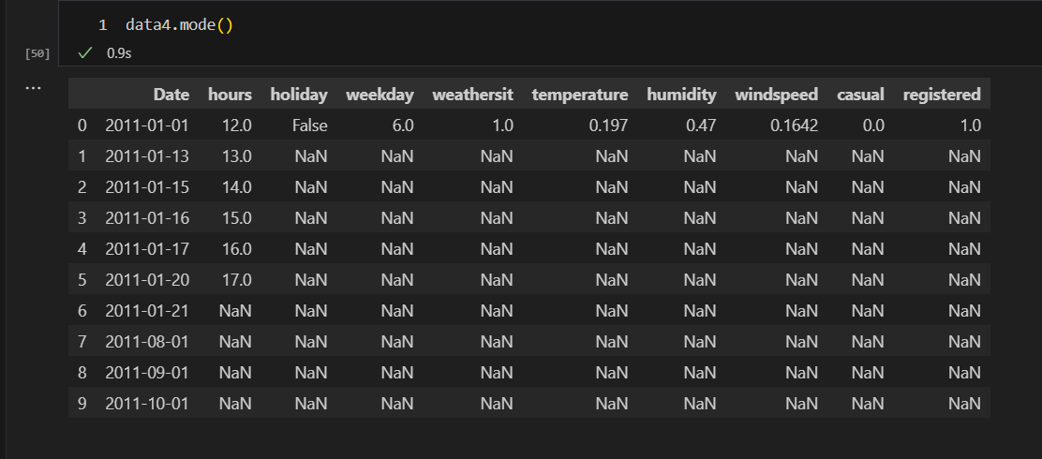
Measure of central tendency of data 4 :-

Slide 7
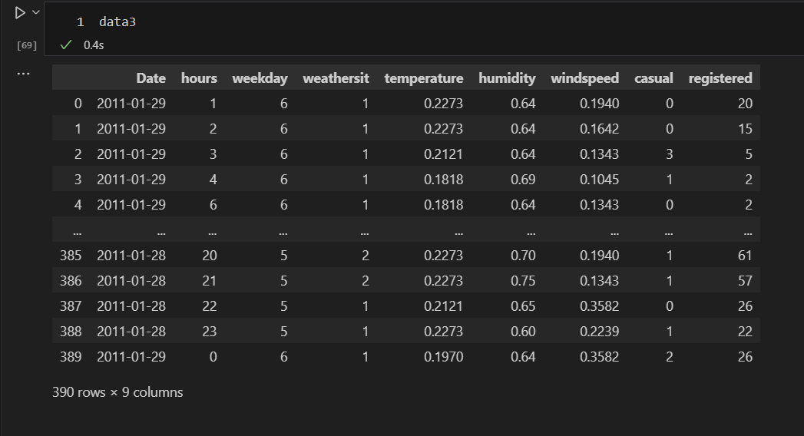
Dataset 3 details :-
In sample data set 3 is much more duplicates value so remove it.
In Dataset remove Unnecessary column due to columns does not giving any useful information.
After cleaning a final dataset show in picture.

Slide 8
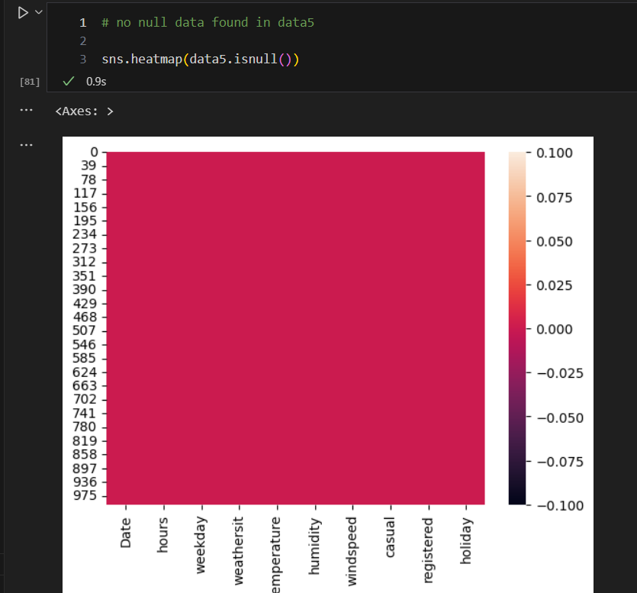
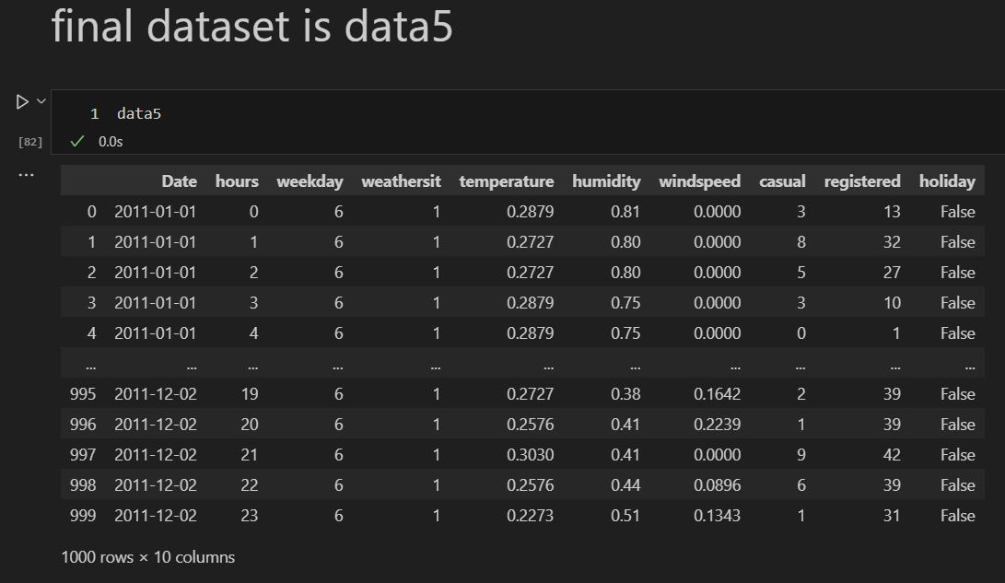
Final Dataset 5 details :-
Merge dataset of 3 and 4 ,after cleaning dataset find new set5
No null value present in dataset 5

Slide 9
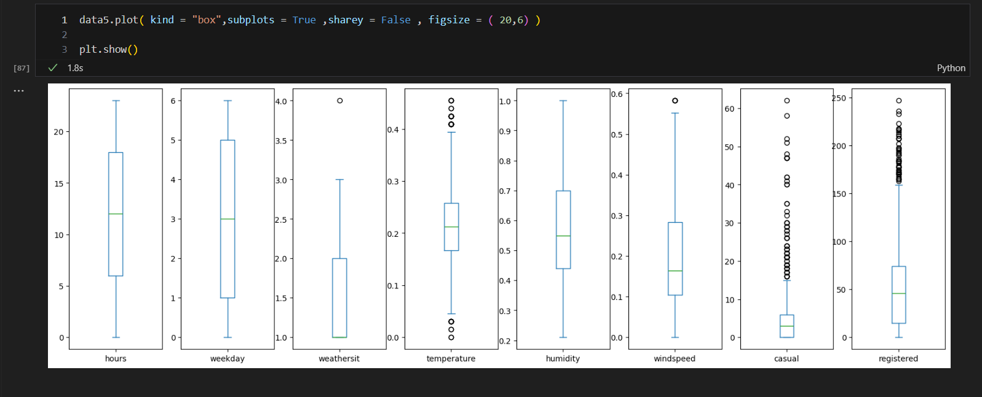
Find outlier in dataset 5 :-
Find outlier with using boxplot

Slide 10
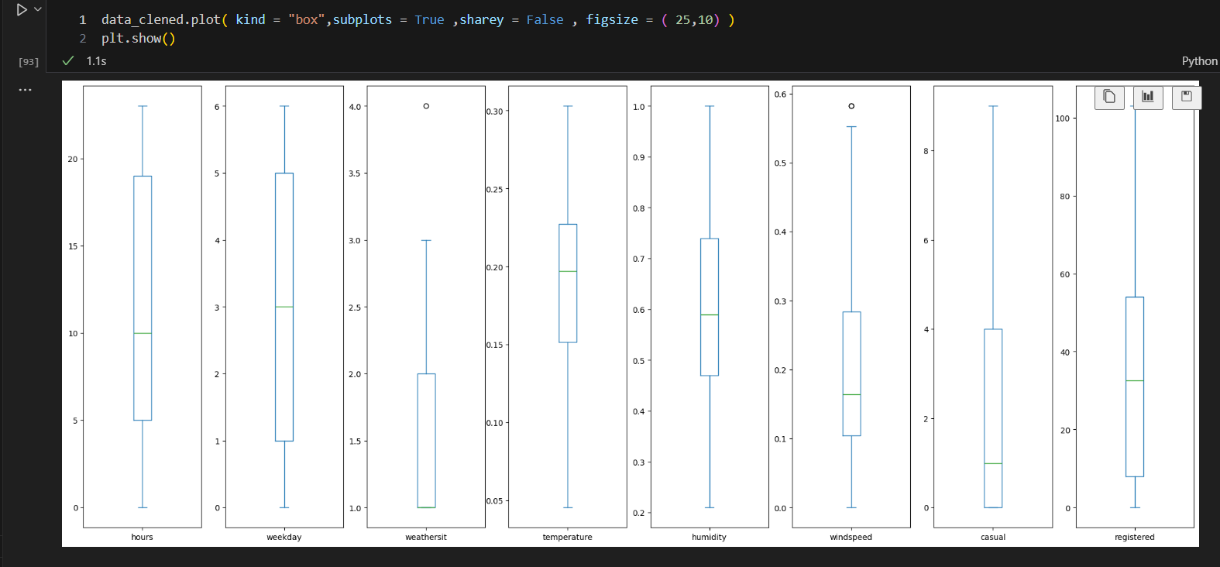
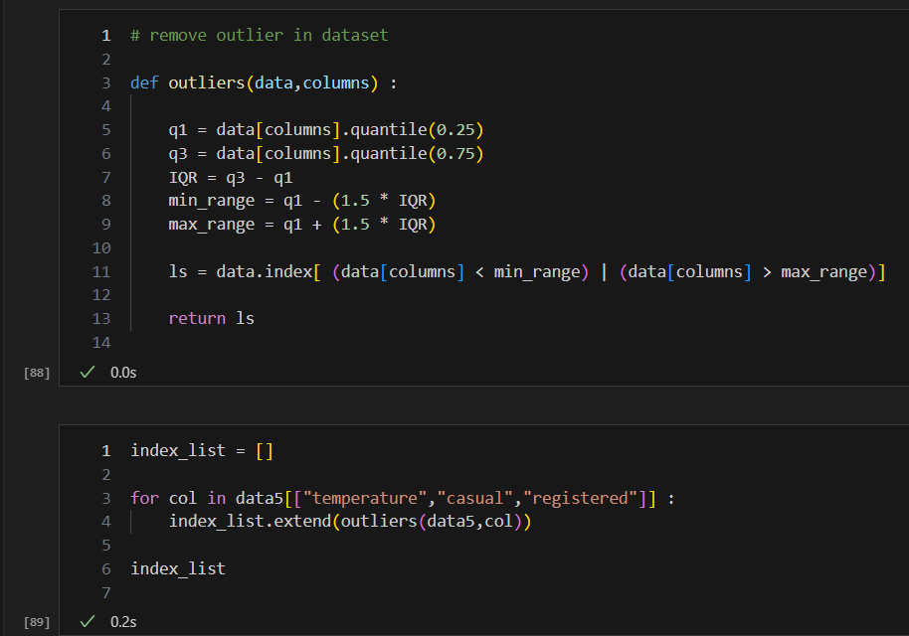
Remove outlier using IQR method :-
After remove outlier ,then making boxplot
Using IQR method , first making of function and find outlier and store in list.
After find outlier then making again a new function of remove outlier and apply in dataset .
After remove outlier in dataset ,find new Dataset.
New dataset making csv file.

Slide 11
What is skewness in Dataset ?
Skewness show is how much data is sprearded.
If skewness value of 0 indicates a per perfectly normal distribution.
Normal distribution meaning is left part and right part is equal.
Check skewness is using histogram and distplot.
Observation :-
1 . Negative skewness :- Mean < Median < Mode
2. positive skewness :- Mode < Median < Mean
3. no skewness :- Mean = Median = Mode

Slide 12
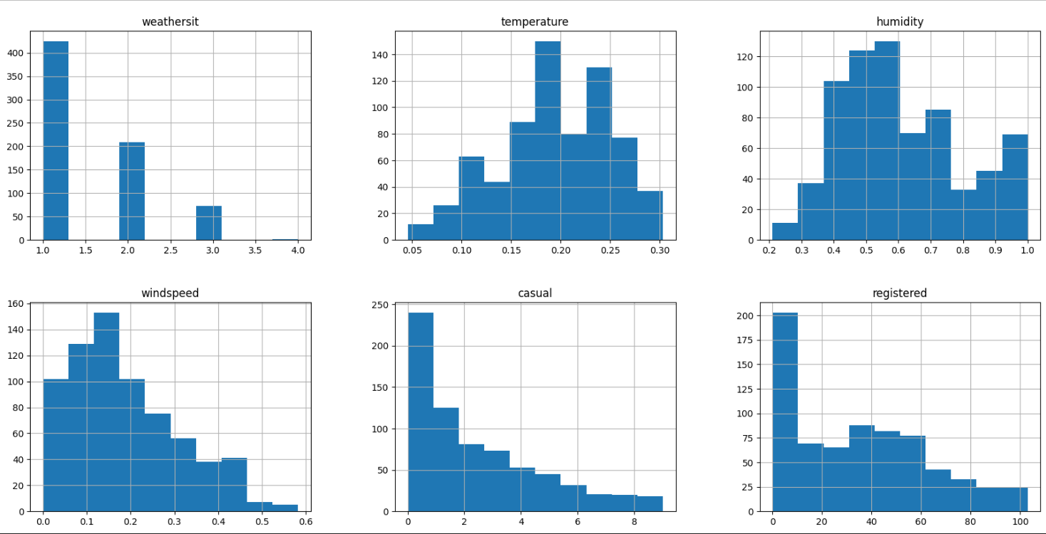
Skewness check of new Dataset :-
Check skewness by using a histogram plot

Slide 13
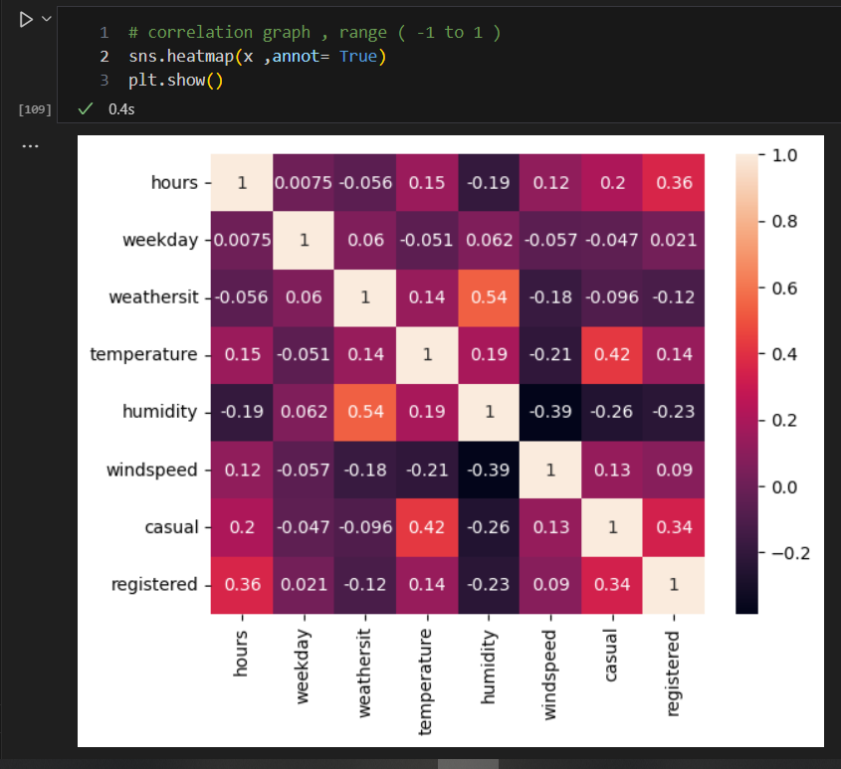
Check correlation of Dataset :-
Correlation check by heatmap

Slide 14
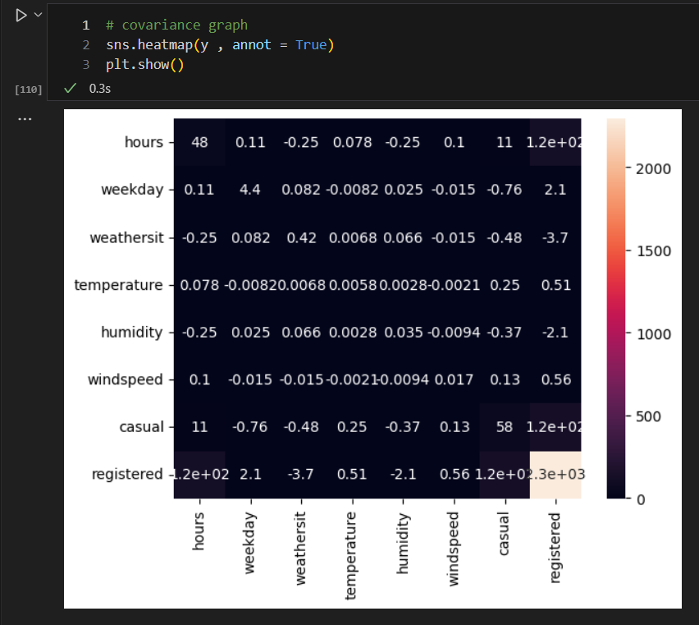
Check covariance of Dataset :-
Check covariance by heatmap

Slide 15
Conclusion :-
We have giving of three data set of weather report – 2011.
We have systematically collects data, processes and performs statistical analyses on data sets.
We have apply different data wrangling techniques and visualizations graph , after that found useful data.
It useful data we can easily use for machine learning algorithms.
In this basis data analysis project I am learning is how to collect row data, how to it process and how to cleaned it.
After that cleaning data apply statical methods for required our criteria.

Slide 16
Thank you

